Slide 1
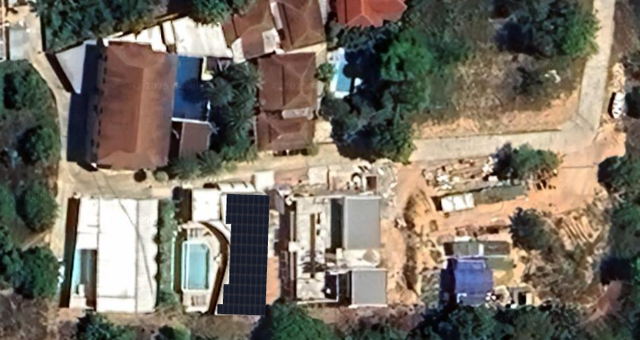
Solar Power Proposal Plai Laem Soi 6 Bo Phut Samui
50 kW grid tie system
+ alternatives
www.entropy.solar 0877221100

Slide 2
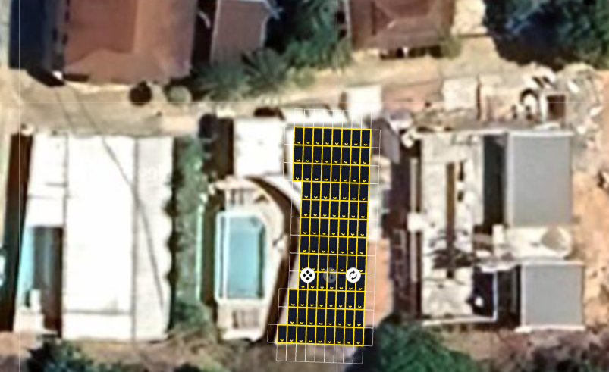
Standard 50kW solar system (PEA bill 50-100k)
50kW grid tie system
50kW monocrystalline array 30 year warranty
50 kW inverter PEA approved 5 -10 year warranty
Array 91 modules in 5 strings 4 MPPTs
System cost 699,950 |  | Annual saving 514,149 |  | RoI 73% |  | Payback 16 months

Slide 3
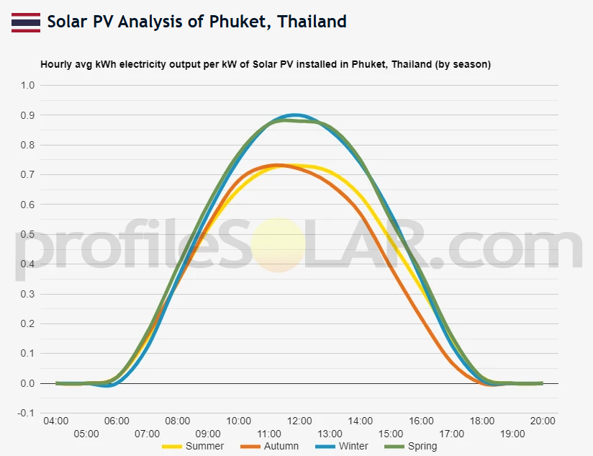
PEA saving analysis (PEA bill 35k-70k)
50 kW system savings
 | Summer | Autumn | Winter | Spring
Power saving (kWh/day) | 272 | 256 | 311 | 320
Saving /day (B) | 1330 | 1252 | 1524 | 1570
Quarterly saving (B) | 121,062 | 113,927 | 138,675 | 142,911
Annual saving (B) | 516,575

Slide 4
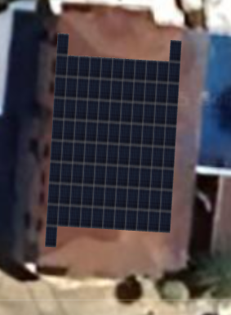
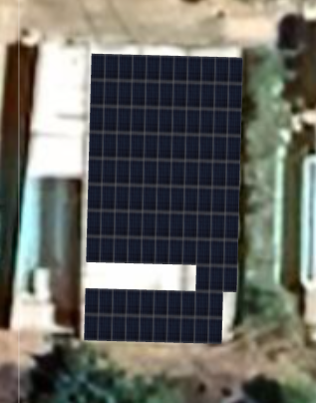
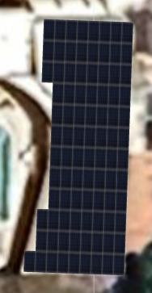
Array Options
3 potential locations
91 modules
50kW array
Recommend option 2
NE building
Pitched roof aligned N – S
Worst solar performace
3. SE house
Low tilt roof furthest from MDB
2. SW house with existing 11kW
Low tilt roof close to MDB

Slide 5
Long term benefits
Assumes 1% array degradation/ year
New inverter years 10 and 20
5 year 1.83 Mil |  | 10 year 4.13 Mil |  | 15 year 6.41 Mil |  | 20 year 8.45 Mil
10.5 million baht net benefit over 25 year life
Support service
1 year Free wifi monitoring |  | 1 year Unlimited service calls |  | 1 year Free cleaning |  | Lifetime Warranty claims
Continued support package year 2 + at 1% system cost

Slide 6
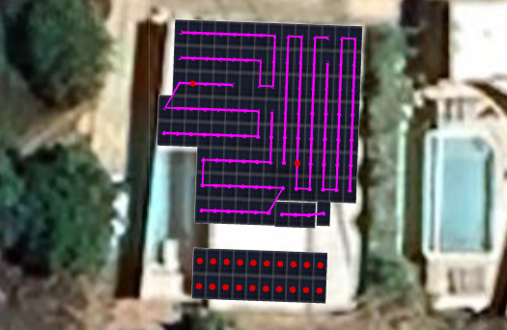
Higher power solar system (PEA bill 60-110k)
57kW grid tie system
58kW monocrystalline array 30 year warranty
50 inverter PEA approved 5 -10 year warranty
Array 104 modules in 5 strings 4 MPPTs
System cost 799,950 |  | Annual saving 562,663 |  | RoI 71% |  | Payback 15 months

Slide 7
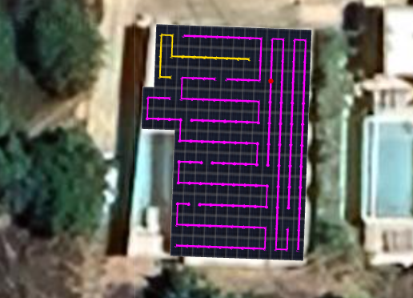
Maximum power solar system (PEA bill 80-110k)
79kW grid tie system
79kW monocrystalline array 30 year warranty
50 + 20 kW inverter PEA approved 5 -10 year warranty
Array 144 modules in 8 strings 6 MPPTs
System cost 959,360 |  | Annual saving 777,595 |  | RoI 81% |  | Payback 15 months

Slide 8
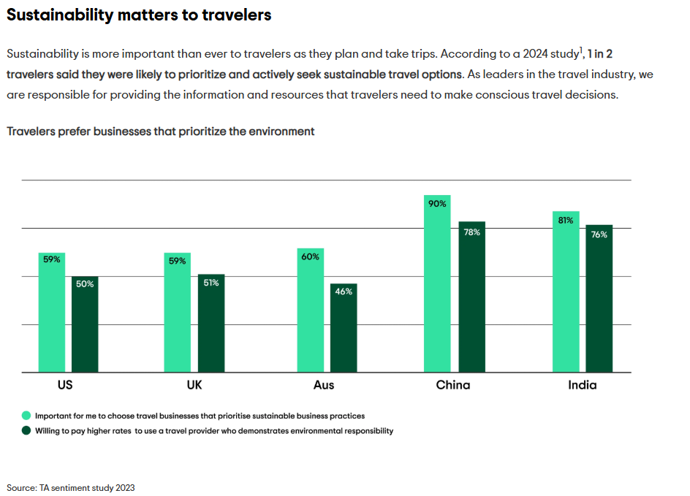
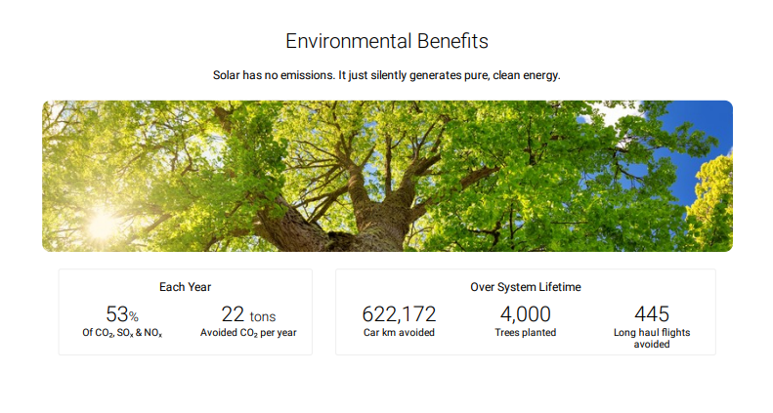
Additional benefits
Marketing Benefits
Promote clean sustainability as a core value
Shading Benefits
Reduced AC demand due to passive shading

Slide 9
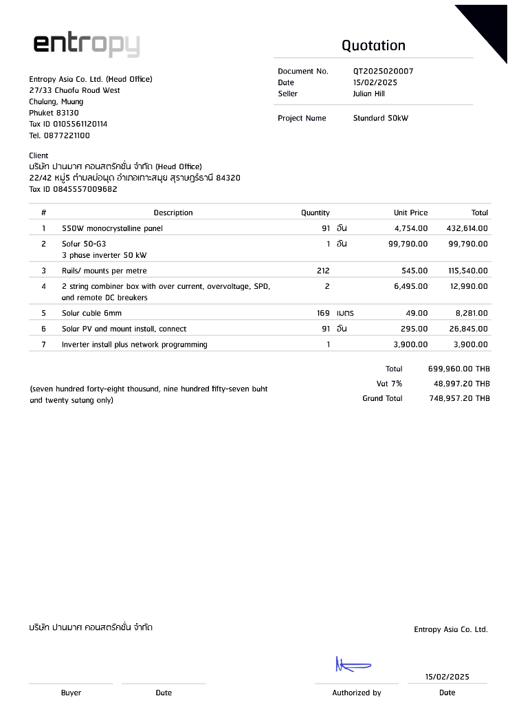

Slide 10
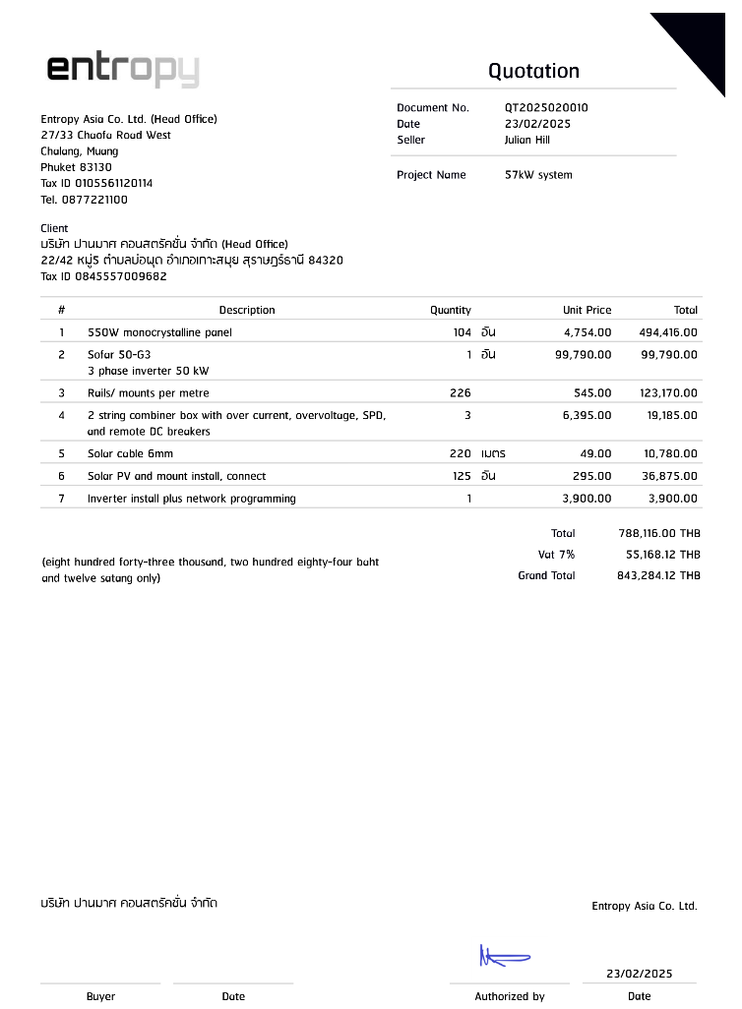

Slide 11
