Slide 1
Solar proposal
Constantine/ Lana
5-10 kW Thalang and Bangtao
installations

Slide 2
Contents
P3 Design goals
P4 Inverter options
P5/6 Costs / returns Thalang
P 7/8 Cost/ returns Bangtao
P9 Recommendations

Slide 3
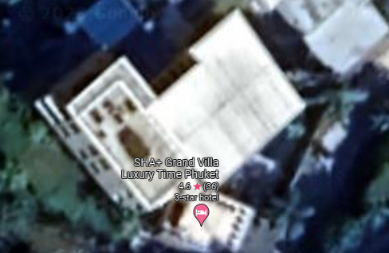
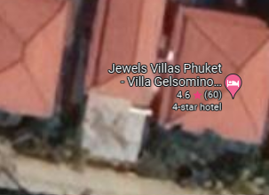
Solar Design
Solar Array
Design goal: Cost effective PEA bill reduction utilizing PV solar panels and inverters.
Option to upgrade in the future.
 | Average bill | Average power
Thalang House | 15,000 | 6.0 kW
Bangtao | 30,000 | 12.0 kW
Solar Array

Slide 4
Inverter options/ relative costs
3 Phase single | 3 phase triple | 3 phase micro
Traditional 3 phase. One big inverter. Maximum flexibility. Can be ‘stacked’. Can add batteries | One inverter per phase.. More expensive but better redundancy. Each phase on 3 single phase inverters. Phase synch issues | Exotic. Each panel has dedicated inverter at roof. Very redundant. Adaptive. Hard to customize settings/ protections. Phase synch issues
Inverter 60,000 Protections 23000 Install/ wiring 25000 | Inverters 3x 20000 = 60,000 Protections 3x 15000 =45,000 Install/ wiring = 32,000 | 16 x 4400 = 70,000 Protections (limited) 15,000 Install /wiring 45,000
108,000
137,000
130,000

Slide 5
Thalang costs/ architecture
Components | Single Inverter 9.6 | Single inverter 6.0 | Hybrid Inverter 9.6 | Triple 1 phase 9.0 | Micro Inverter 9.0
16x 600W panels mono | 105,600 ฿ |  | 105,600 ฿
15X 600W panels mono |  |  |  | 99,000 ฿ | 99,000 ฿
10X 600W panels mono |  | 66000 ฿
3 phase inverter 6/10kW | 59,950 ฿ | 44950 ฿ | 104,950 ฿ | 59850 ฿ | 70,400 ฿
Protections/ wiring | 48,000 ฿ | 48000 ฿ | 53,720 ฿ | 77,000 ฿ | 60,000 ฿
Panel frame | 24,000 ฿ | 18000 ฿ | 24,000 ฿ | 24000 ฿ | 24,000 ฿
Test/ debug | 8,000 ฿ | 8000 ฿ | 10,000 ฿ | 10,000 ฿ | 12,000 ฿
Total | 245,550 ฿ | 184,900 ฿ | 298,270 ฿ | 269,850 ฿ | 265,400 ฿
Cost /W | 25.58 ฿ | 30.81 ฿ | 31.07 ฿ | 29.98 ฿ | 29.48 ฿

Slide 6
Thalang investment return
Components | Single Inverter 9.6 feed in | Single inverter 9.6 limited | Single inverter 6.0 feed in | Single inverter 6.0 limited
Cost | 245600 ฿ | 245600 ฿ | 184900 ฿ | 184900 ฿
Annual return | 92,505 ฿ | 57816 ฿ | 57816 ฿ | 57816 ฿
ROI% | 37.8% | 23.5% | 31.2% | 31.2%
Payback (months) | 31.8 Months | 51.0 Months | 38.37 Months | 38.37 Months

Slide 7
Bangtao costs/ architecture
Components | Single Inverter 9.6 | Stacked inverters 19.2 | Hybrid Inverter 9.6 | Triple 1 phase 9.0 | Micro Inverter 9.0
16x 600W panels mono | 105,600 ฿ |  | 105,600 ฿
32X 600W panels mono |  | 211,200 ฿ |  | 99,000฿ | 99,000 ฿
3 phase inverter 10/20 kW | 59,950 ฿ | 119,900 ฿ | 104,950 ฿ | 59850 ฿ | 70,400 ฿
Protections/ wiring | 57,000 ฿ | 77000 ฿ | 59,000 ฿ | 77,000 ฿ | 60,000 ฿
Panel frame | 27,000 ฿ | 54000 ฿ | 27,000 ฿ | 24000 ฿ | 24,000 ฿
Test/ debug | 8,000 ฿ | 12000 ฿ | 10,000 ฿ | 10,000 ฿ | 12,000 ฿
Total | 257,550 ฿ | 474,100 ฿ | 306,550 ฿ | 269,850 ฿ | 265,400 ฿
Cost /W | 26.82 ฿ | 24.69 ฿ | 31.93 ฿ | 29.98 ฿ | 29.48 ฿

Slide 8
Bangtao investment return
Components | Single Inverter 9.6 feed in | Single inverter 9.6 limited | Stack inverter 19.2 feed in | Stack inverter 6.0 limited
Cost | 257,550 ฿ | 257550 ฿ | 474100 ฿ | 474100 ฿
Return/ Year | 92,505 ฿ | 92505 ฿ | 188865 ฿ | 120450 ฿
ROI | 35.6% | 35.6% | 39.8% | 25.4%
Payback (months) | 33.4 Months | 33.4 Months | 30.1 Months | 47.2 Months

Slide 9
Our Recommendation: Thalang : 6 kW single inverter bangtao: 10 kw single inverter
Analogue meters, we can increase to 9.6 kW and 20kW respectively

Slide 10
TIMELINE
Title
To start a presentation, go to the Slide Show tab, and select From Beginning.
Title
During your presentation, the speaker notes are visible on your monitor, but aren't visible to the audience.
Title
Title
The Notes pane is a box that appears below each slide. Tap it to add notes.
If you don’t see the Notes pane or it is completely minimized, click Notes on the task bar across the bottom of the PowerPoint window.
Title
Deposit
Construct
frames
Install inverters and test
+2 days
+2 days
+7 days
+5 days
Order
equipment
Install panels/ wiring

Slide 11
deposits
 | Milestone | Thalang | Bangtao
First deposit | Order inverters/ panels | 165,550 | 165,550
Second deposit | Frame finished | 24,000 | 27,000
Final payment | System finish | 56,000 | 65,000
Total payments |  | 245,550 | 257,550

Slide 12
Thank you
Julian 0877221100
Entropy Asia Co. Ltd

