Slide 1
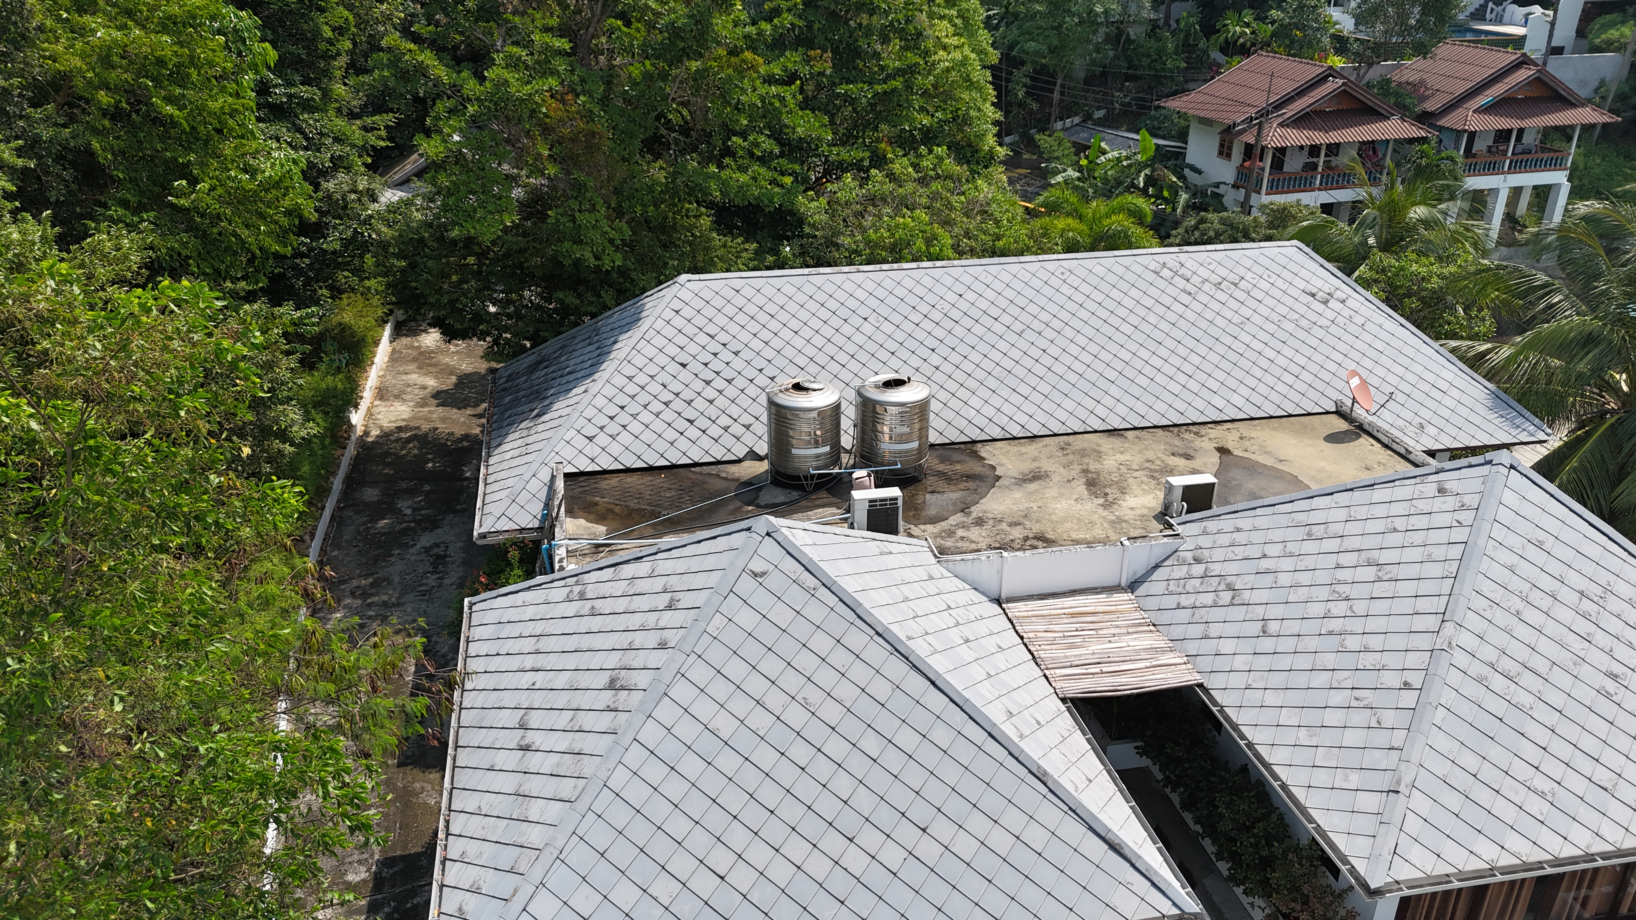
Solar Power Proposal
Eitan Goldberg, Koh Phangan
www.entropy.solar 0877221100

Slide 2
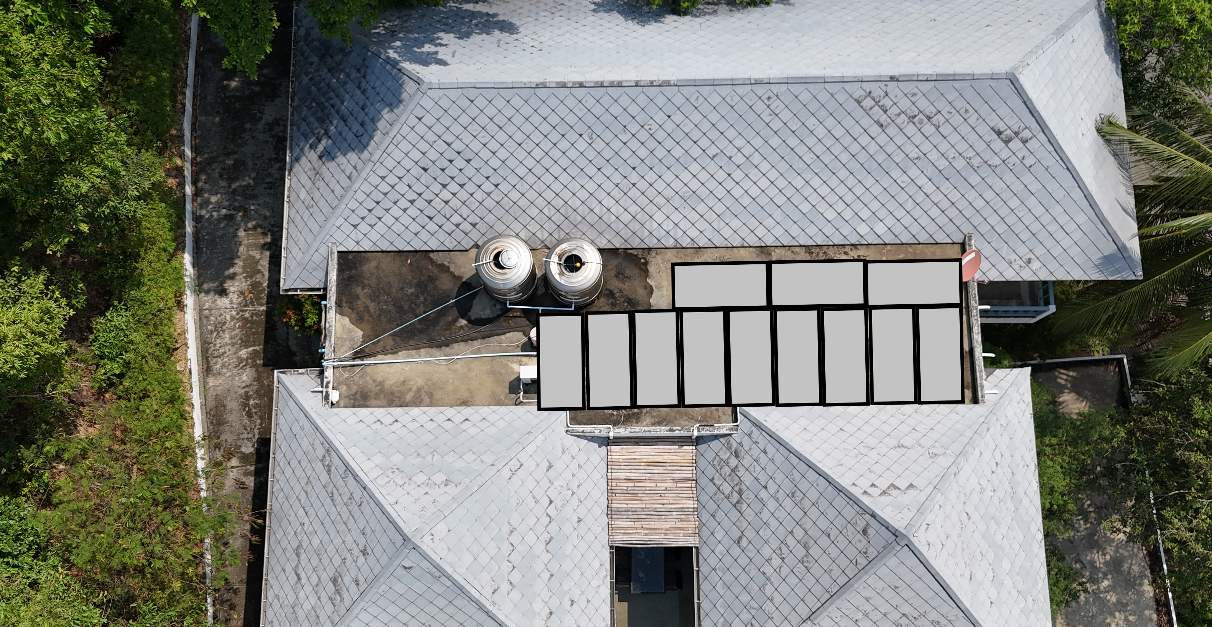
Recommended solar system
6.6 kW grid tie system
6.6 kW monocrystalline array 30 year warranty
6 kW inverter PEA approved 5 year warranty
System cost 157,019 |  | Annual saving 65.083 |  | RoI 41% |  | Payback 29 months
Grid tie system does not have battery backup during PEA outage

Slide 3
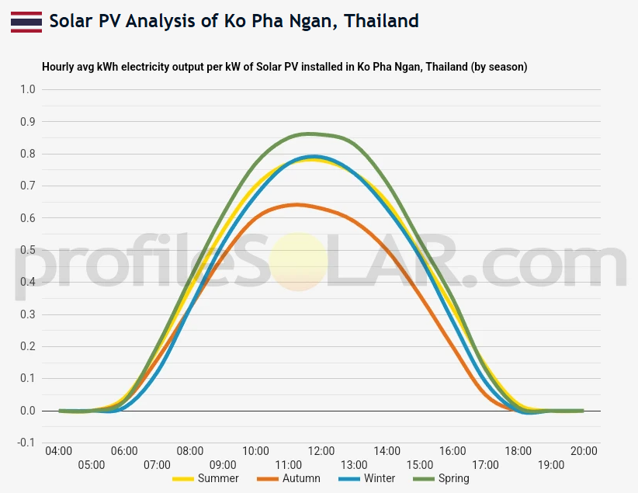
6.6 kW system savings
 | Summer | Autumn | Winter | Spring
Daily energy (kWh) | 38 | 30 | 36 | 42
Saving 90 day (B) | 16926 | 13377 | 16052 | 18728
Daily saving (B) | 186 | 147 | 176 | 206
Annual saving (B) | 65,083

Slide 4
Long term benefits
5 year 162,000 |  | 10 year 430,000 |  | 15 year 716,000 |  | 20 year 958,000
1.21 million baht net benefit over 25 year life
Support service
1 year Free wifi monitoring |  | 1 year Unlimited service calls |  | 1 year Free cleaning |  | Lifetime Warranty claims
Continued support package year 2 + at 1.5% system cost

Slide 5
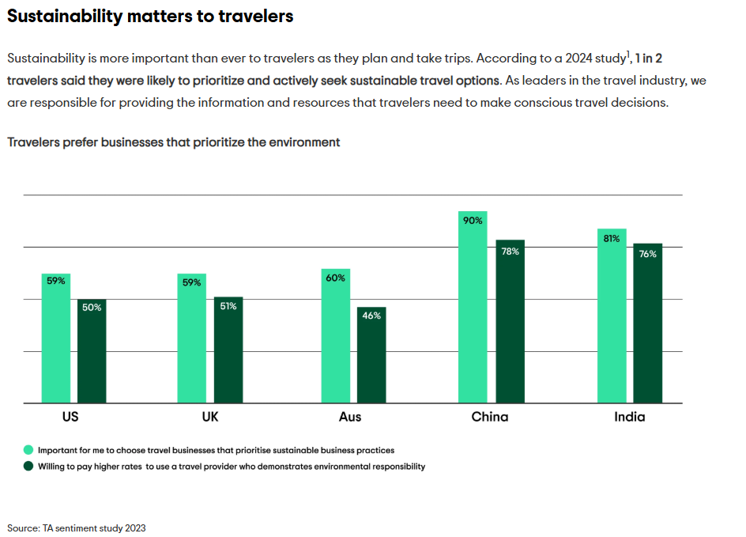
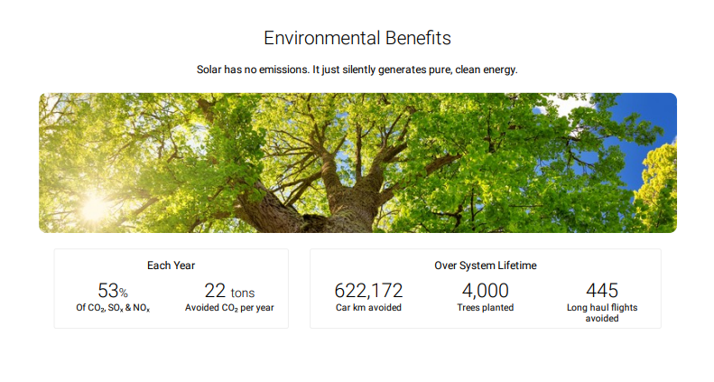
Additional benefits
Property / Rental Value
Resale value to environmentally and cost conscious buyers

Slide 6
