Slide 1
Solar proposal
Gallery Cafe
Rawai installation

Slide 2
Contents
P3 Design goals
P4 Inverter options
P5/6 Costs / returns Thalang
P7 Recommendations

Slide 3
Install solar panels free
Normally 79,900 3.3 kW
99,900 5.5kW
Pay for electricity consumption only 3.95 baht v 4.7 baht PEA
System will reduce PEA electricity by the amount of solar production
We will maintain the array and never increase electricity cost
System life 20 years +
Clean power reduces global warming, CO2, and pollution

Slide 4
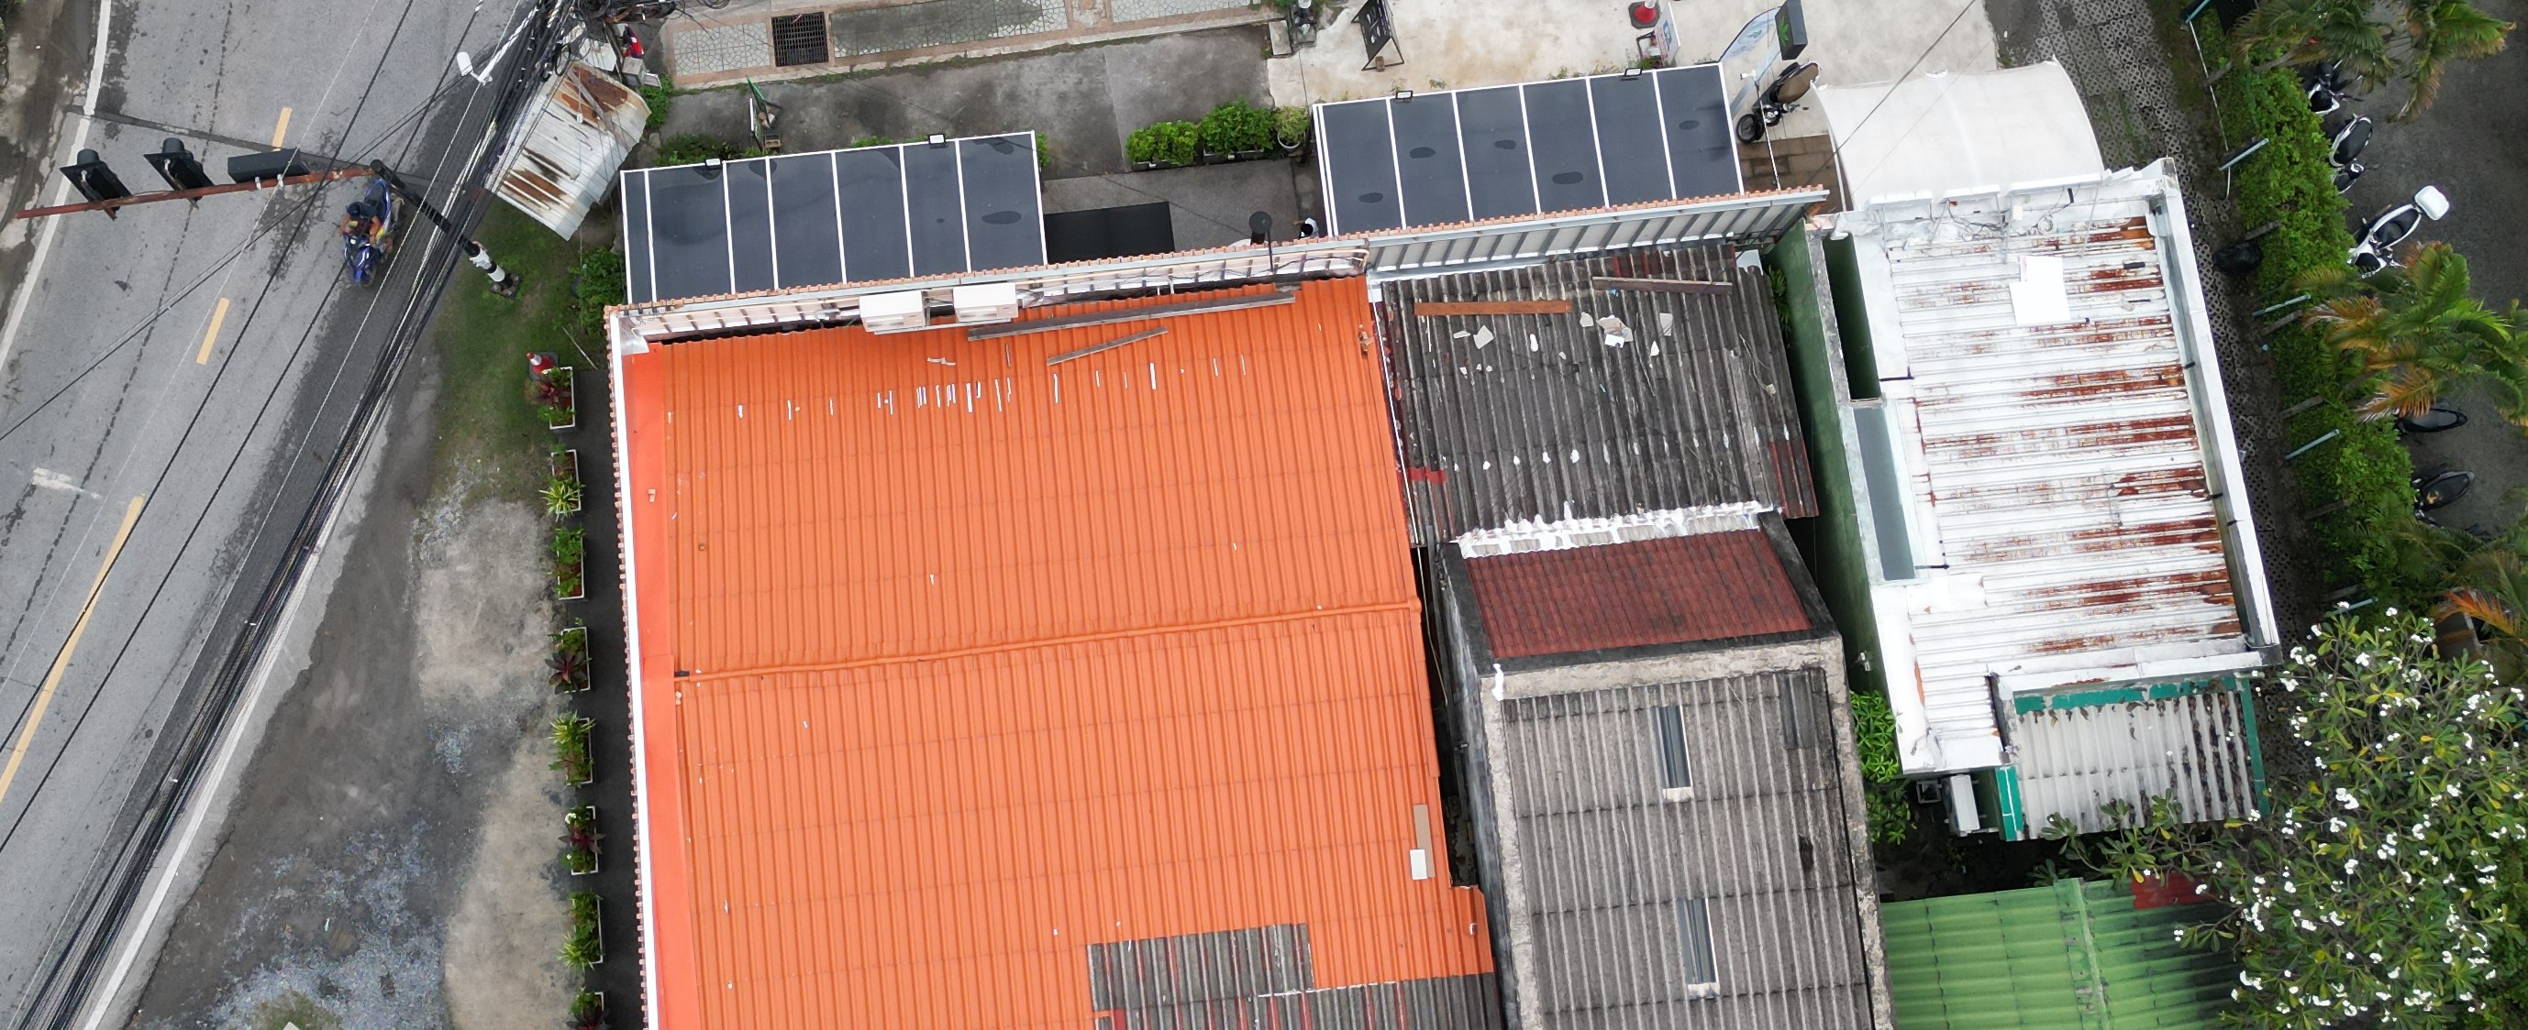
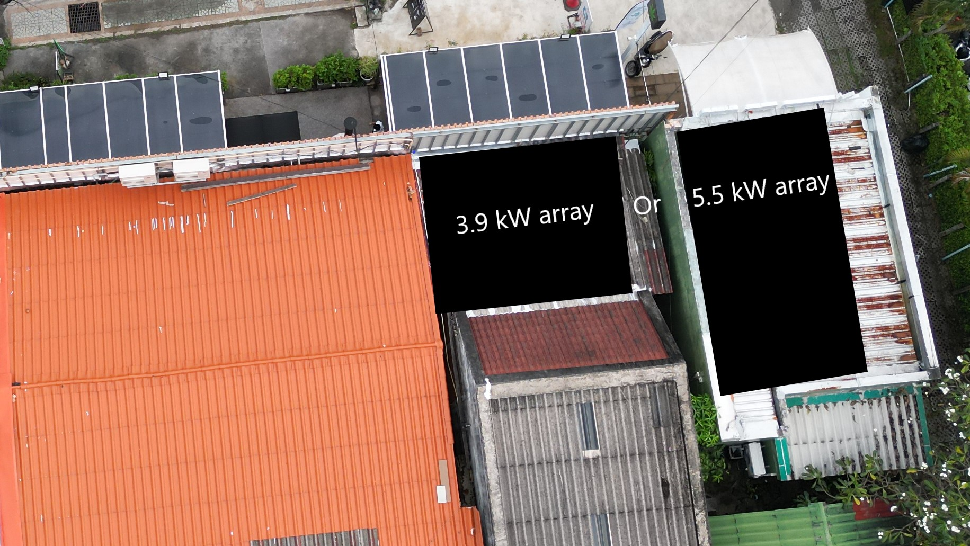
Free solar
Free solar array and installation
3kW or 5kW system
Pay only for electricity used at 16% less than PEA.
Lifetime price guarantee

Slide 5
Savings
 | 3.9 KW | 5.5 KW
PEA cost/ month | 3047 ฿ | 4290 ฿
Solar cost/ month | 2545 ฿ | 3584 ฿
Saving / month | 502 ฿ | 706 ฿
Saving per year | 6024 + | 8472 +
System life saving | 120000-150000 | 170,000-250,000

Slide 6
signage
Promote clean power
Attract environmentally
sensitive customers
Help entropy promote solar across Rawai

Slide 7
Thank you
Julian 0877221100
Entropy Asia Co. Ltd

