Slide 1
Solar proposal
Manfred
4.2 kW panels / 5kW inverter
Saiyuan 6 Rawai installation

Slide 2
Contents
P3 Design goals
P4 Inverter options
P5/6 Costs / returns Thalang
P 7/8 Cost/ returns Bangtao
P9 Recommendations

Slide 3
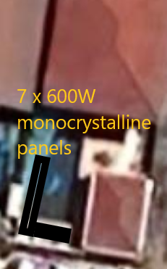
Solar Design
Solar panels around pool at west and south walls
Clearance for gate operation/ maintenance at south wall
Inverter in utility room next to distribution panel.
DC fuse, circuit breaker and surge protectors. AC breaker and power meter
Route DC power through old outside power and retile with customer tiles

Slide 4
costs/ architecture
Components | Single Phase Inverter 5kW
7x 600W panels mono | 52,500 ฿
Sofar 5kW inverter | 26,500 ฿
Custom steel support frame | 17,800 ฿
Shower modification | 4,500 ฿
Protections/ meter/ wiring | 16,200 ฿
Test/ debug | 9,000 ฿
Total | 125,500 ฿
Cost /W | 29.88 ฿

Slide 5
investment return
Cost | 125500 ฿
Annual return | 43,230 ฿
ROI% | 34.4%
Payback (months) | 34.9 Months

Slide 6
TIMELINE
Title
To start a presentation, go to the Slide Show tab, and select From Beginning.
Title
During your presentation, the speaker notes are visible on your monitor, but aren't visible to the audience.
Title
Title
The Notes pane is a box that appears below each slide. Tap it to add notes.
If you don’t see the Notes pane or it is completely minimized, click Notes on the task bar across the bottom of the PowerPoint window.
Title
Deposit
Construct
frames
Install inverters and test
+2 days
+2 days
+5 days
+2 days
Order
equipment
Install panels/ wiring

Slide 7
deposits
 | Milestone
First deposit | Order panels/ inverters. Next day delivery | 89,000
Second deposit | Frame finished. Deliver protection box | 14,000
Final payment | System finish | 22,500
Total payments |  | 125500

Slide 8
Thank you
Julian 0877221100
Entropy Asia Co. Ltd

