Slide 1
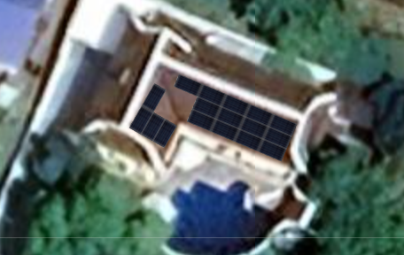
Solar Power Proposal
www.entropy.solar 0877221100

Slide 2
Recommended solar system (PEA bill 12k)
System limited by roof area to 17 modules
11kW grid tie system
9.5kW monocrystalline array 30 year warranty
11 kW inverter PEA approved 10 year warranty
System cost 181,287 |  | Annual saving 93,645 |  | RoI 52% |  | Payback 23 months

Slide 3
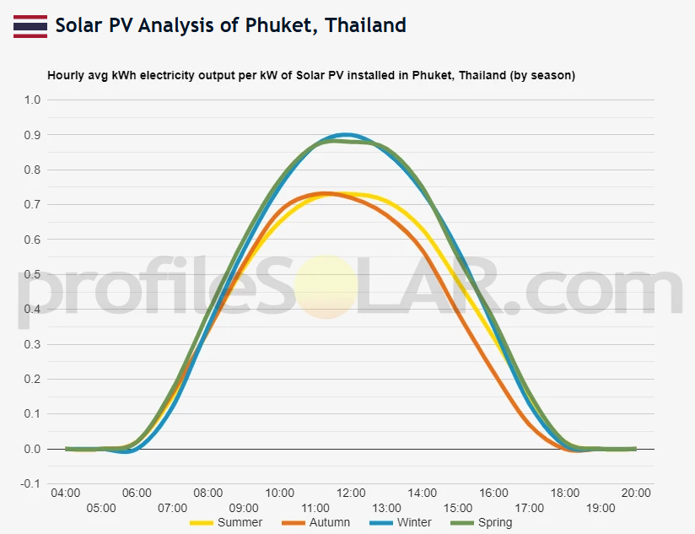
9 kW system savings
 | Summer | Autumn | Winter | Spring
Power saving (kWh) | 51 | 48 | 58 | 60
Saving 90 day (B) | 22750 | 21403 | 25862 | 26754
Daily saving (B) | 250 | 235 | 284 | 294
Annual saving (B) | 93645

Slide 4
Long term benefits
Assumes
1% array degradation/ year linear warranty
Inverter replacement years 10 and 20
5 year 277,000 |  | 10 year 654,000 |  | 15 year 1.06 Mil |  | 20 year 1.40 Mil
1.76 million baht net benefit over 25 year life
Support service
1 year Free wifi monitoring |  | 1 year Unlimited service calls |  | 1 year Free cleaning |  | Lifetime Warranty claims
Continued support package year 2 + at 1% system cost

Slide 5
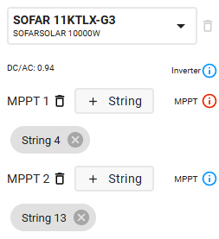
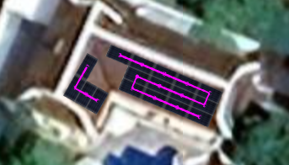
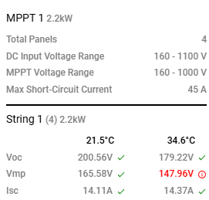
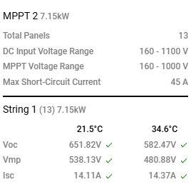
Array / inverter configuration check
May need additional 100W small module
on panel group 2 (4 modules) to raise
Vmc to <150 Vmin
Or reduce to 1 string 7 kW system with 5.5
inverter
 |  | Cost |  | Cost/kW |  | RoI
9kW +100W module |  | 181,287 |  | 19.39 |  | 51%
7kW/5.5 inverter |  | 144,457 |  | 20.73 |  | 49%
Prices include installation and wifi, exclude VAT 7%

Slide 6
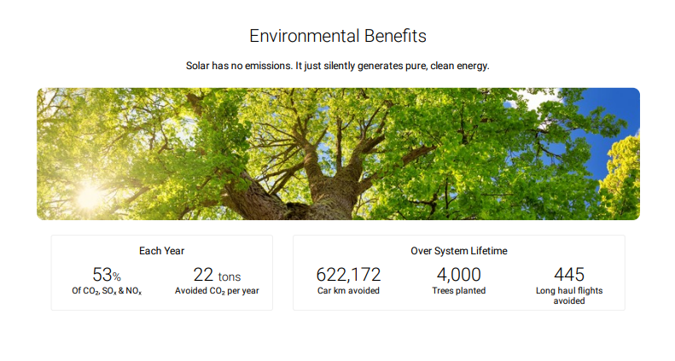
Additional benefits
Property Value
Adds to resale value
Shading Benefits
Reduced AC demand due to passive shading

Slide 7
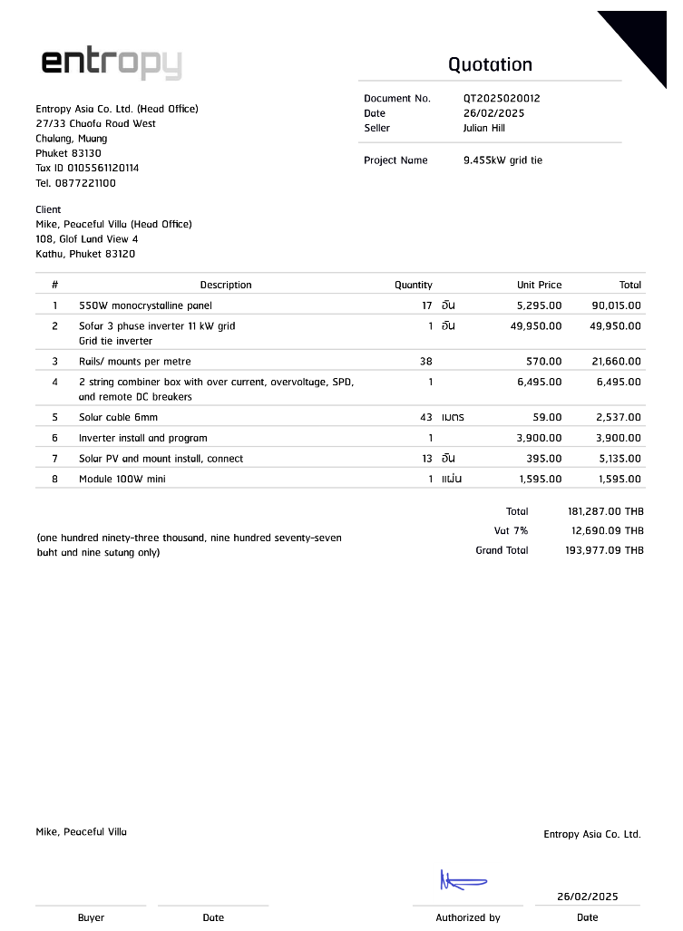

Slide 8
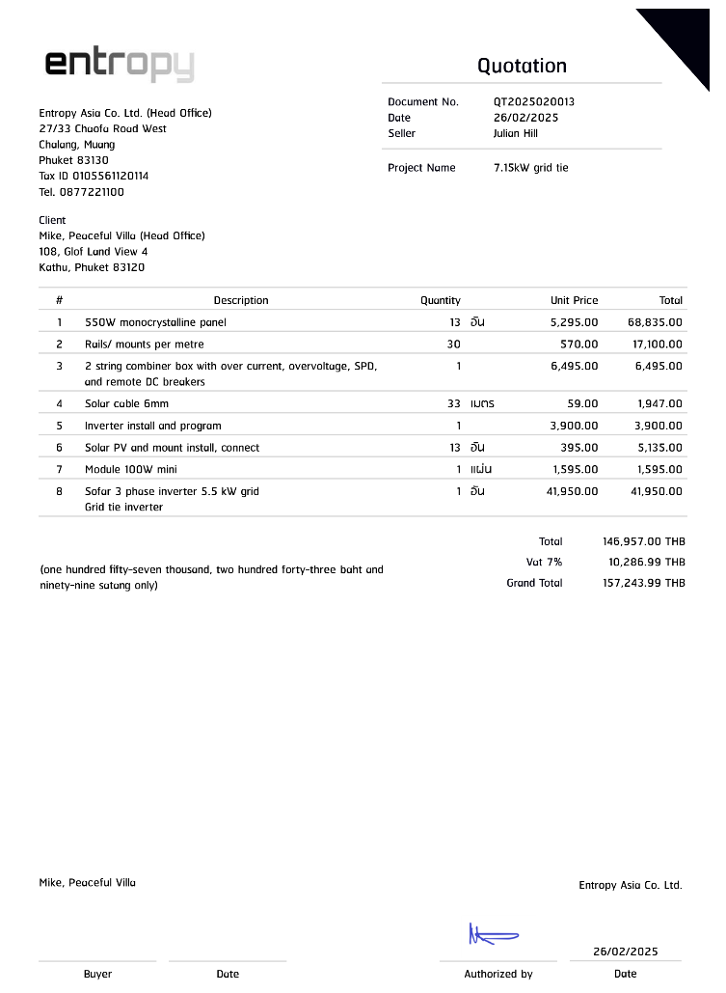

Slide 9
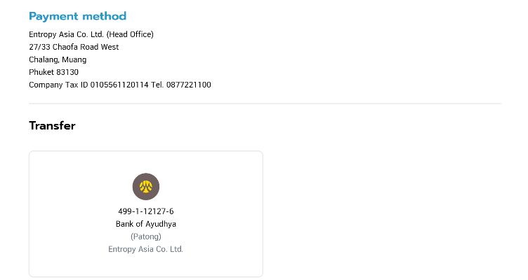
Project scheduling
All components in stock, Phuket warehouse
Earliest install queue date: 1 March 2025
Expected install duration: 1-2 days
Expected electricity outage: 30 minutes
Payment schedule | 9.45 kW | 7.15 kW
Deposit; reserve date / materials | 20,000 | 20,000
All materials delivered | 60,000 | 90,000
Array mounted at nominal Voc, inverter mounted | 45,000 | 45,000
System configured at nominal performance | 32,244 | 38,977

