Slide 1
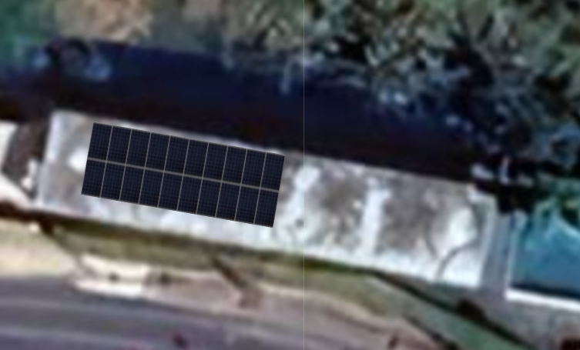
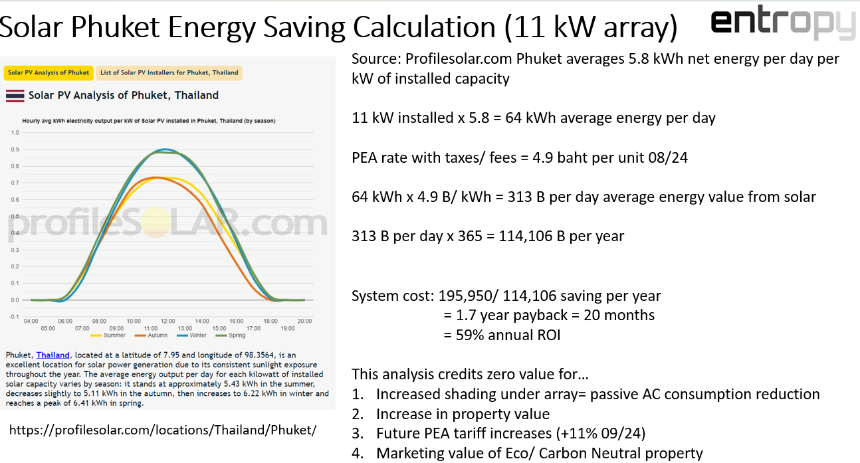
Paul, Rawai Solar Proposal QT2024080005 attachment
Warranty
Modules 30 year linear performance
Inverter: 5 years
Rails, combiner: 10 years
Payment
20% reserve date
30% deliver array
30% array complete, inverter
deliver
20% system complete
operational
Installation
3 days max from agreed start
11 kW system components
10 wide x 2 array at 190 degrees azimuth
Powitt Solar 550W modules PW-72M550HM10
Sofar 11KTLX-G3 inverter
Single string @806 V_{DC}
Combiner /safety box with 2 fuse, 2 MCB, 2 SPD
Est 48 m 6mm solar cable
Wifi monitoring via Solarman app
Installation, programming, 1 year service

