Slide 1

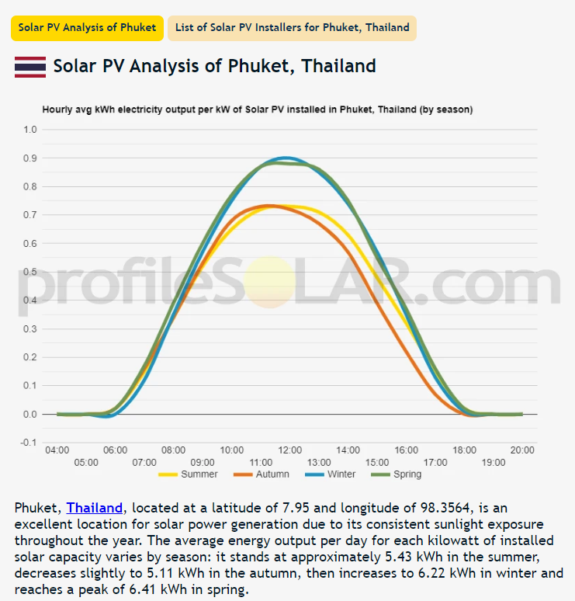
Solar Phuket Energy Saving Calculation
Source: Profilesolar.com Phuket averages 5.8 kWh net energy per day per kW of installed capacity
15.4 kW installed x 5.8 = 89 kWh average energy per day
PEA rate with taxes/ fees = 4.9 baht per unit 08/24
89kWh x 4.9 B/ kWh = 437 B per day average energy value from solar
437 B per day x 365 = 159,542 B per year
System cost: 280,000/ 159,542 saving per year
= 1.7 year payback = 20 months
= 57% annual ROI
This analysis credits zero value for…
Increased shading under array= passive AC consumption reduction
Increase in property value
Future PEA tariff increases (+11% 09/24)
Marketing value of Eco/ Carbon Neutral property
https://profilesolar.com/locations/Thailand/Phuket/

Slide 2
Lifetime savings (30 years)
Assumptions
1% array degradation per year (warranty)
Annual cleaning cost + new inverter year 10
PEA will keep rates unchanged (unlikely)

Slide 3
Solar Phuket Energy Saving Calculation (+20% array)
Source: Profilesolar.com Phuket averages 5.8 kWh net energy per day per kW of installed capacity
17.6 kW installed x 5.8 = 102 kWh average energy per day
PEA rate with taxes/ fees = 4.9 baht per unit 08/24
89kWh x 4.9 B/ kWh = 500 B per day average energy value from solar
500 B per day x 365 = 182,570 B per year
System cost: 304,000/ 182,570 saving per year
= 1.66 year payback = 20 months
= 60% annual ROI
This analysis credits zero value for…
Increased shading under array= passive AC consumption reduction
Increase in property value
Future PEA tariff increases (+11% 09/24)
Marketing value of Eco/ Carbon Neutral property
https://profilesolar.com/locations/Thailand/Phuket/

Slide 4
Lifetime savings (30 years)
Assumptions
1% array degradation per year (warranty)
Annual cleaning cost + new inverter year 10
PEA will keep rates unchanged (unlikely)

