Slide 1
Solar proposal
Sergei
2.8 kW panels / 5.5kW inverter
Rawai installation

Slide 2
Contents
P3 Design goals
P4 Inverter options
P5/6 Costs / returns Thalang
P7 Recommendations

Slide 3
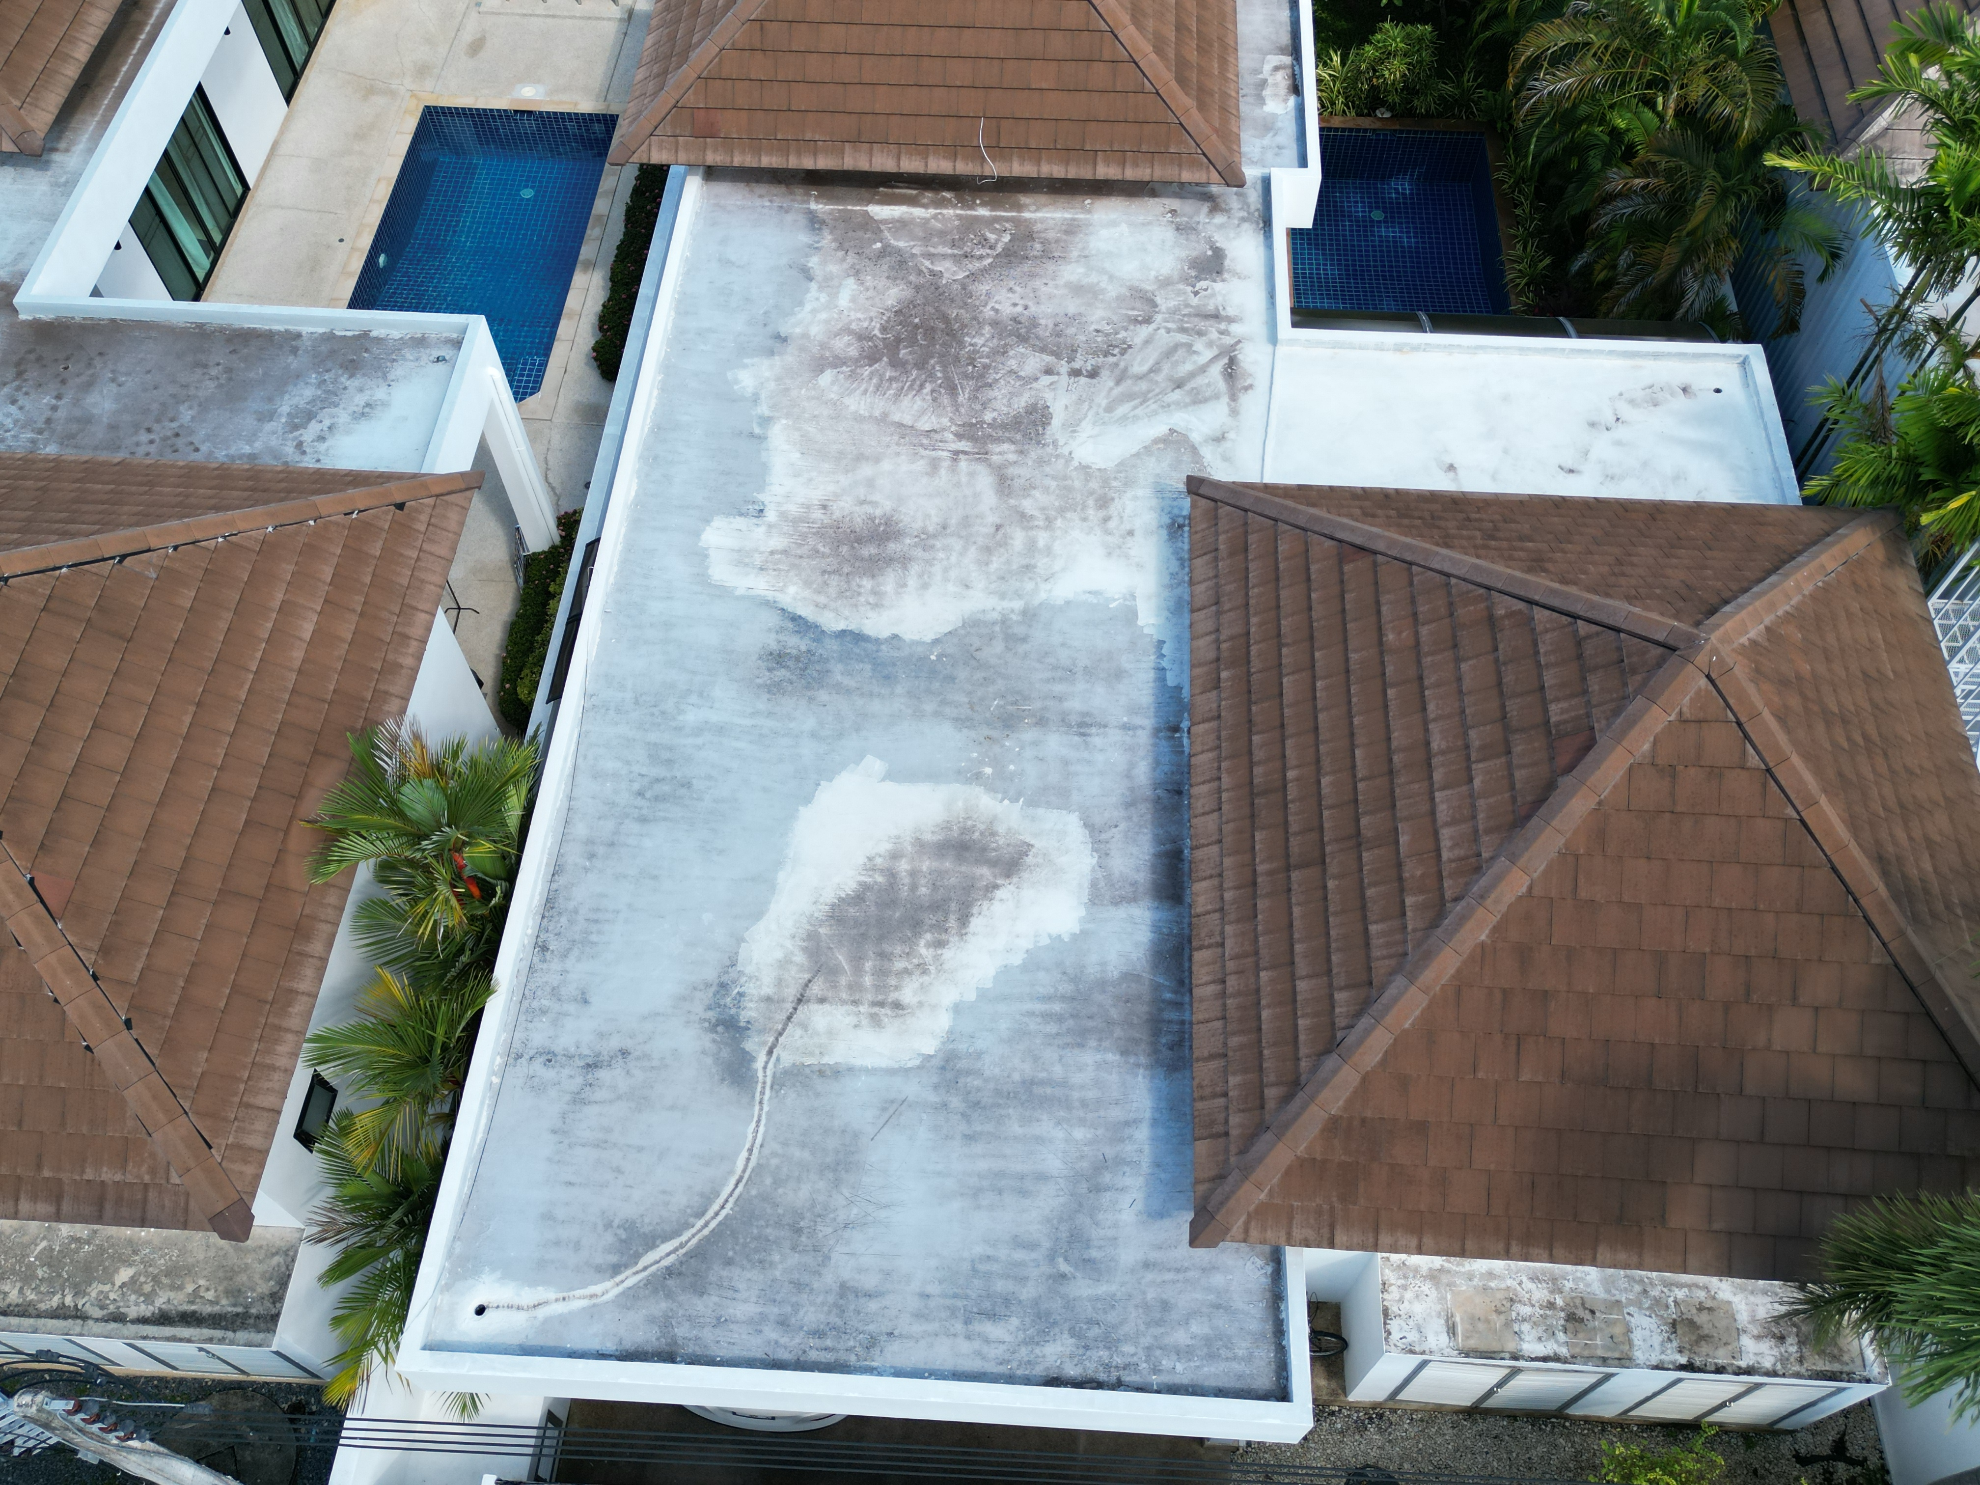
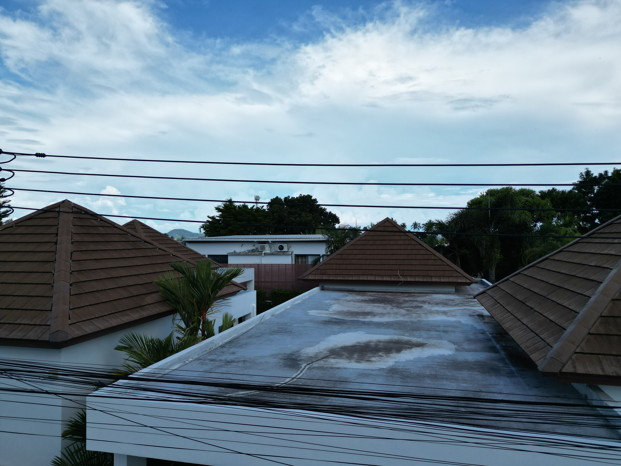
Solar Design
Solar array
Shaded March to September
Solar panels on flat roof
Mount at East end to avoid shading from west raised roof
Inverter in car park next to distribution panel.
DC fuse, circuit breaker and surge protectors. AC breaker and power meter

Slide 4
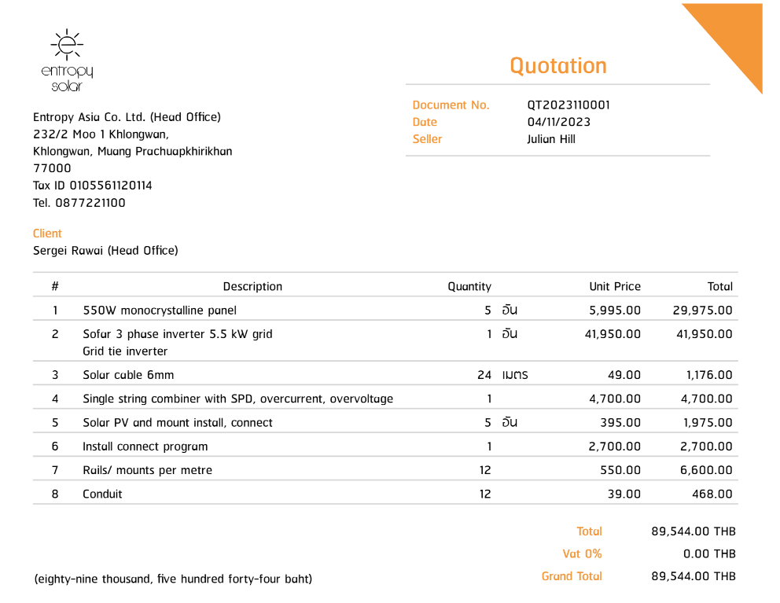
costs
Additional cable wiring for revised mounting location

Slide 5
investment return
Cost | 89544 ฿
Annual return | 33,230 ฿
ROI% | 37.1%
Payback (months) | 32.3 Months

Slide 6
TIMELINE
Title
To start a presentation, go to the Slide Show tab, and select From Beginning.
Title
During your presentation, the speaker notes are visible on your monitor, but aren't visible to the audience.
Title
Title
The Notes pane is a box that appears below each slide. Tap it to add notes.
If you don’t see the Notes pane or it is completely minimized, click Notes on the task bar across the bottom of the PowerPoint window.
Title
Deposit
Install mounts and panels
+1 days
+1 days
+1 days
Install inverters and test
Stage
equipment

Slide 7
deposits
 | Milestone
First deposit | Order panels/ inverters. Next day delivery | 45,000
Final payment | System finish | 44,544
Total payments |  | 89544

Slide 8
Thank you
Julian 0877221100
Entropy Asia Co. Ltd

